Slide 1

Retail Sales Analysis Using SQL
Prepared by: Gehad Elberady

Slide 2
Project Overview
Retail Sales Analysis project using SQL
Focuses on analyzing sales data to extract business insights
Covers full SQL workflow:
Database creation
Data cleaning
Data analysis
Business insights

Slide 3
Project Objectives
Create and structure a retail sales database
Clean data and handle missing values
Perform Exploratory Data Analysis (EDA)
Answer real business questions using SQL queries

Slide 4
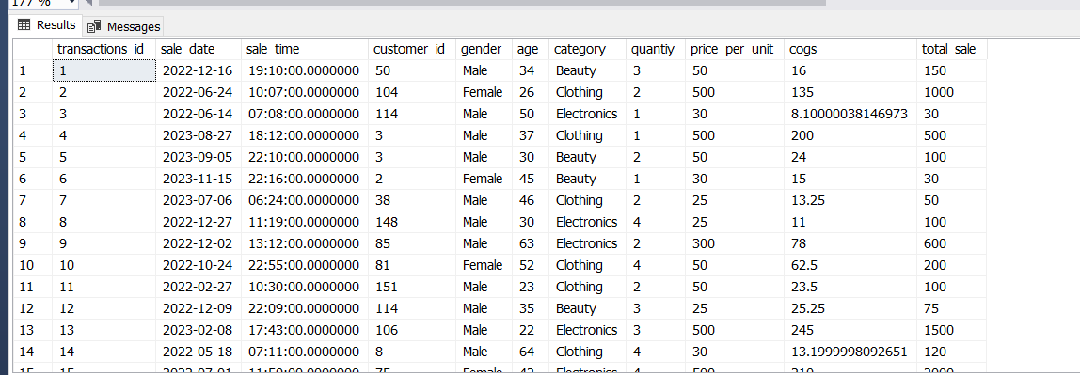
Dataset Description
Table: retails_sales

Slide 5
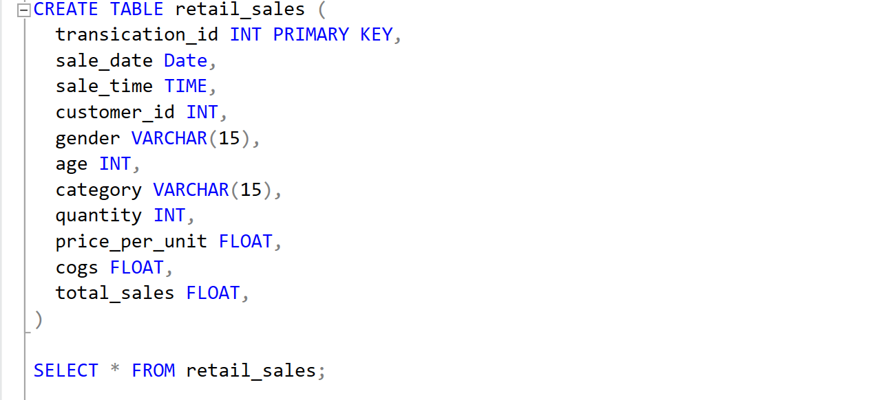
Database Setup

Slide 6
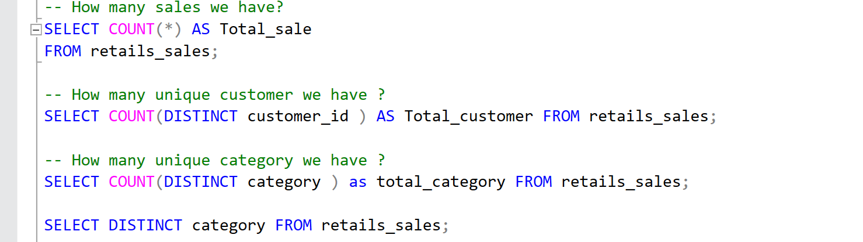
Data Exploration
View data
Understand structure
Check total records and uniqueness

Slide 7
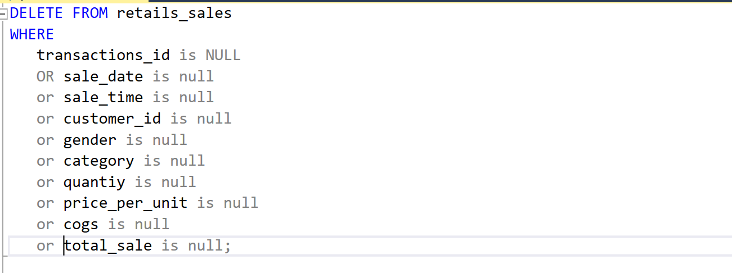
Data Cleaning

Slide 8
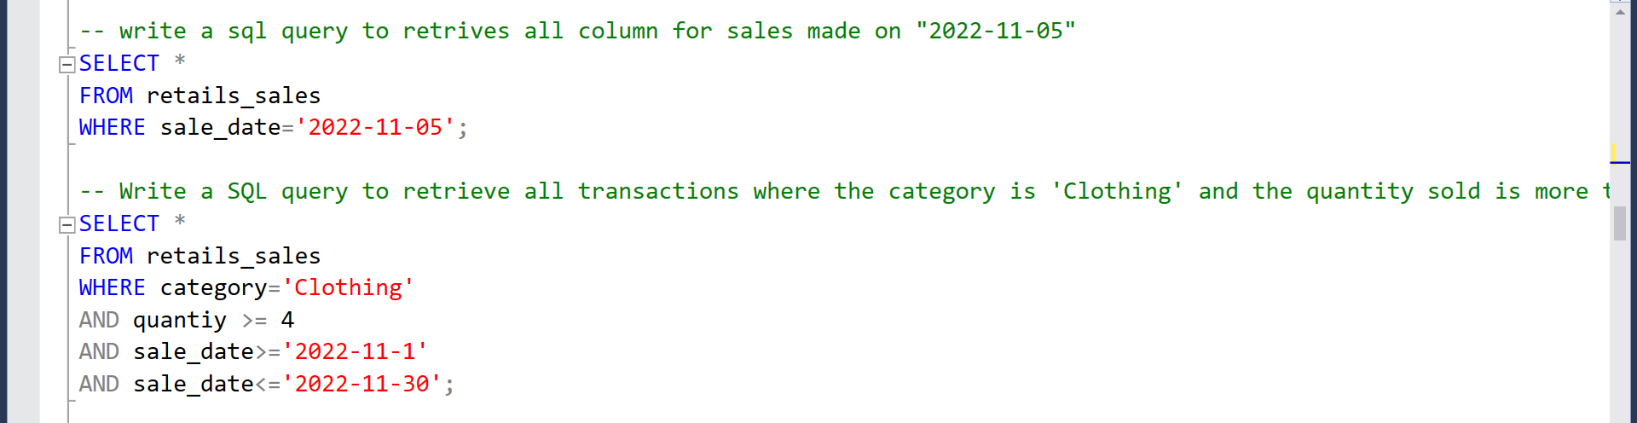
Business Question

Slide 9
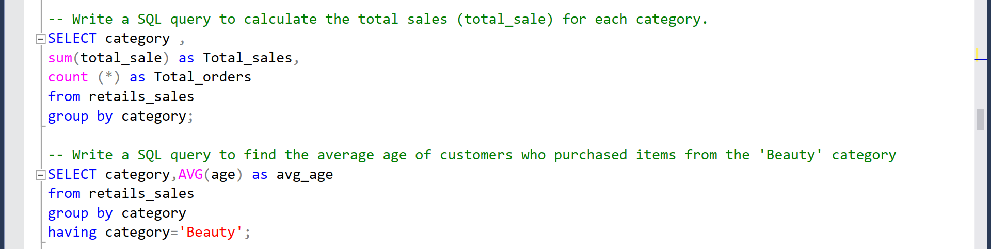
Business Question

Slide 10
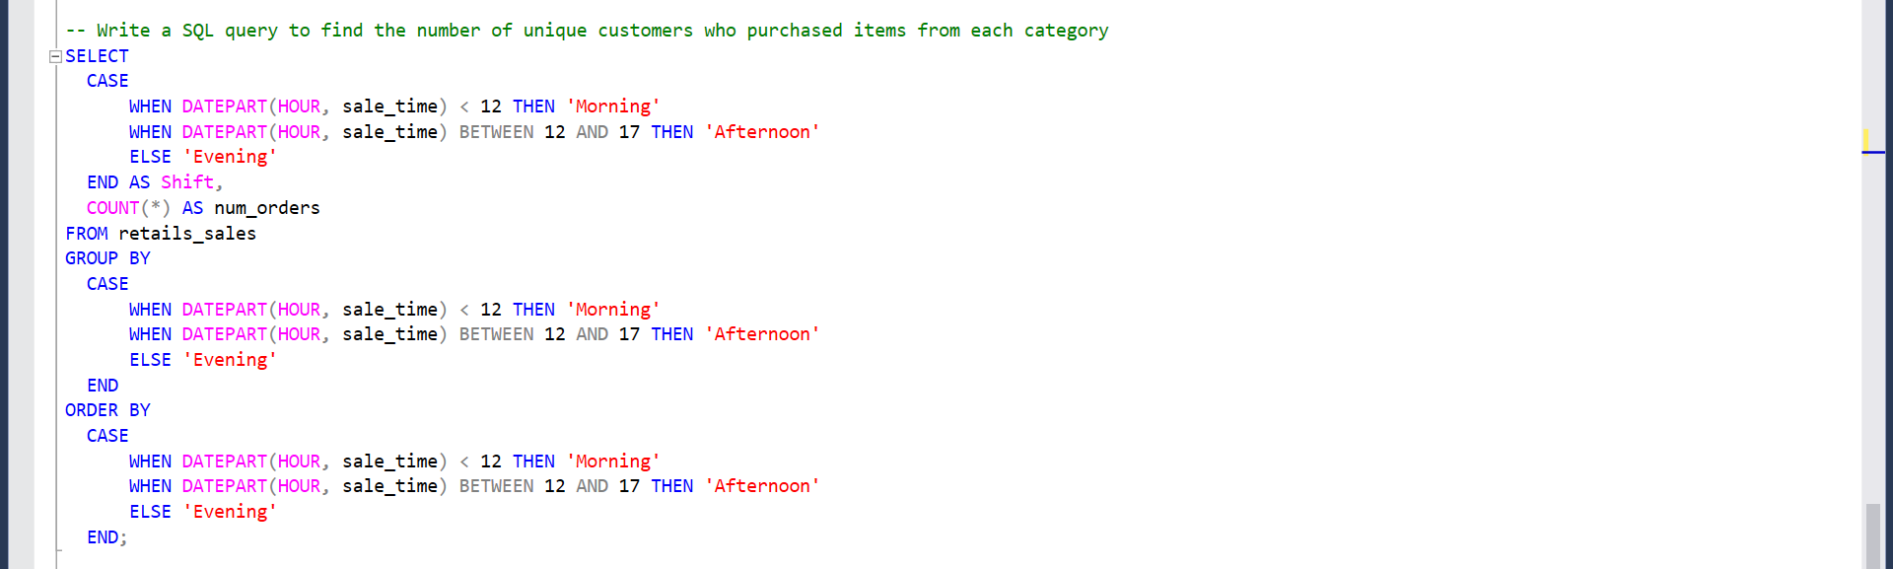
Business Question

Slide 11
Thank You

